Slide 1

The Future of Careers at the Intersection of Climate Change and Public Health
What Can Job Postings and an Employer Survey Tell Us?
Heather Krasna, MS, Columbia University Mailman School of Public Health/ Maastricht University, the Netherlands
APHA Session #: 3065.0

Slide 2
Is there a demand for graduates with training in both climate change and public health?
Introduction
Climate change has well-documented public health impacts
Climate change is now a required competency for public health degree programs in Europe and Australia
Little research exists on employer perspectives on need for public health graduates with climate change training
Main findings
Skills/competencies required by surveyed employers align with climate and health competencies from ASPHER, CAPHIA, and the Global Consortium on Climate and Health Education
Job market is small but growing

Slide 3
Methods and Key Results
Survey of 450 relevant employers
87 respondents; 91.7% expect need for graduates to grow
Analysis of 32,093 jobs posted on publichealthjobs.org over 16 years
Significant increase in postings mentioning “climate change” or “global health” (p < 0.0001, Poisson regression)
Analysis of 159 job postings on Indeed.com (“climate change” OR “global warming”) AND (“public health” OR “environmental health” OR epidemiology OR “health policy”)
Top occupations: community organizers 23%, professors 11%, environmental health 9%, lawyers 6%
Sectors: non-profit 48%, corporate 20%, government 11%, academia 21%

Slide 4
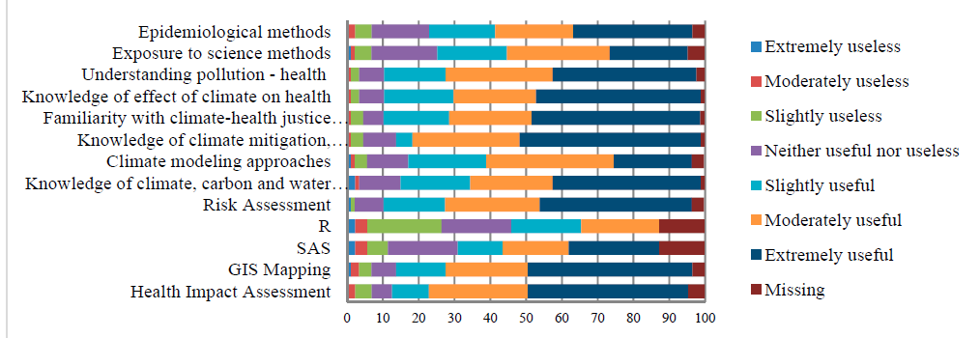
Findings: Employer Survey

Slide 5
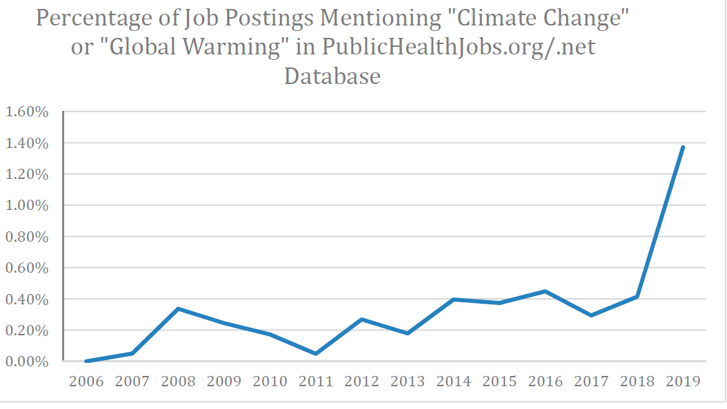

Slide 6
Key Skills Requested by Employers
Population Health Exposure:
Health impact assessment
GIS Mapping
Risk assessment
Pollution-health consequences, causes and sources
Scientific methods
Epidemiological methods
Climate-Related Knowledge
Knowledge of climate, carbon and water cycles
Climate modeling
Climate change mitigation/adaptation
Statistics
Statistical & epidemiological analysis/software (SAS, R)
Other
Communications/writing
Climate justice/equity
Financing/Budgeting/Economic analysis
Policy analysis
Systems thinking/critical thinking
Ecological/Agricultural/Geological/ Environmental knowledge
Interdisciplinary understanding
Marketing; advocacy

Slide 7
Contact: hk2778@cumc.columbia.edu
Citation:
Krasna H, Czabanowska K, Jiang S, Khadka S, Morita H, Kornfeld J and Shaman J, The Future of Careers at the Intersection of Climate Change and Public Health: What Can Job Postings and an Employer Survey Tell Us?
International Journal of Environmental Research and Public Health (Feb. 2020)

